Slide 1
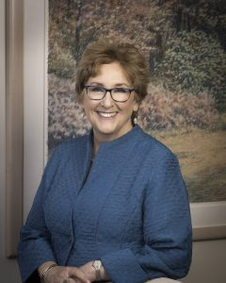
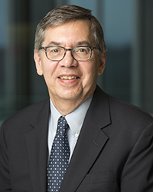
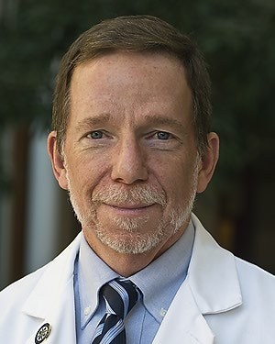
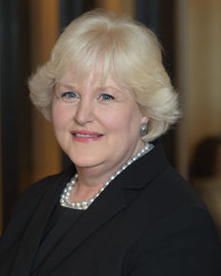
ASPO Survivorship, Health Outcomes & Comparative Effectiveness Research Special Interest Group presents: Meta-vivors: Enhancing survivorship care for survivors with metastatic disease
Thanks to advances in cancer therapies, including the advent of immunotherapy, many survivors are now living longer with metastatic disease. A comprehensive understanding of survivorship care for survivors with metastatic disease is needed. This webinar will present an overview of research on the experiences that patients with metastatic cancer survivors face, and then will present on the experiences of two survivors.
Date: January 22, 2020
Time: 3:00pm-4:00pm ET
Link: https://cwru.zoom.us/j/110399540
Deb Mayer, PhD, RN, AOCN, FAAN
University of North Carolina at Chapel Hill
Paul Jacobsen, PhD
National Cancer Institute
Thomas Smith, MD
Johns Hopkins
Amy Berman,
RN, LHD, FAAN John A. Hartford Foundation

